Slide 1
3D object creation and applying transformations
Dr. Sk. Md. Masudul Ahsan
Professor
CSE, KUET
Md Tajmilur Rahman
Lecturer
CSE, KUET

Slide 2
What you will see today
How to draw a 3D Object
Different Coordinate System
Camera/View Space
Orthogonal Projection
Perspective Projection
Viewport

Slide 3
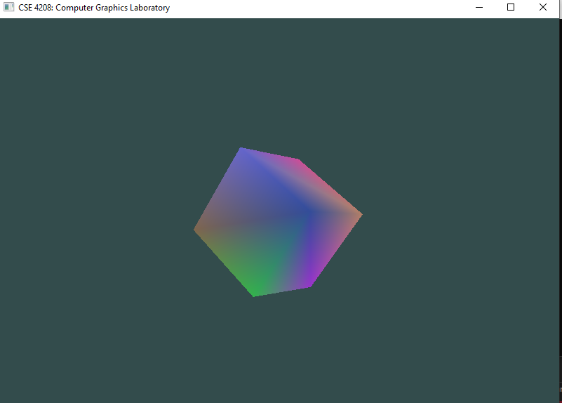
How to draw a 3D Object?

Slide 4
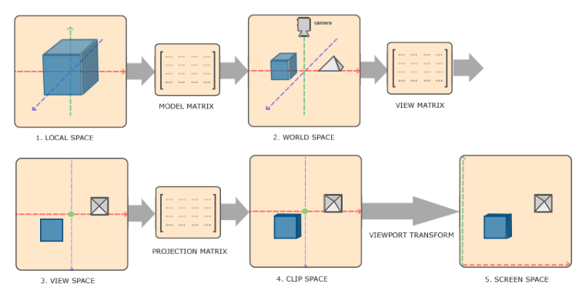
Different Coordinate System

Slide 5
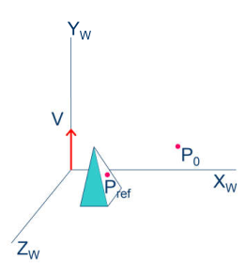
Camera/ View Space
Specification:
  P0 : View or eye point
  Pref : Center or look at point
  V : View-up vector plane
glm::mat4 glm::lookAt(
glm::vec3 eye, // camera position
glm::vec3 direction, // looks at direction
glm::vec3 up // camera's up direction
);

Slide 6
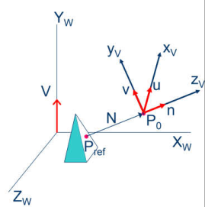
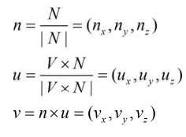
Camera/View Space
Computation
  Zv = N = P0 – Pref
  Xv = V × N = U
  Yv = N × U

Slide 7
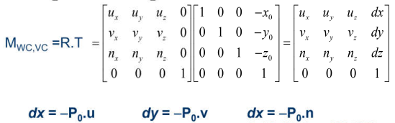
Camera/View Space
dz

Slide 8
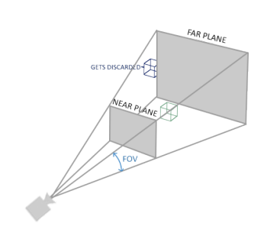
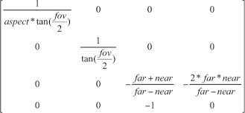
Perspective Projection

Slide 9
GLM Projection Matrix
glm::mat4 glm::perspective(
float fovy, // field of view (vertical)
float aspect, // width / height
float near, // near clipping plane
float far // far clipping plane
);

Slide 10
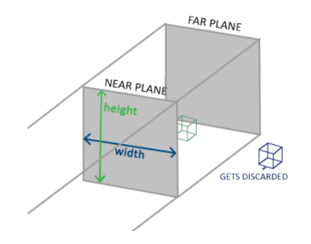
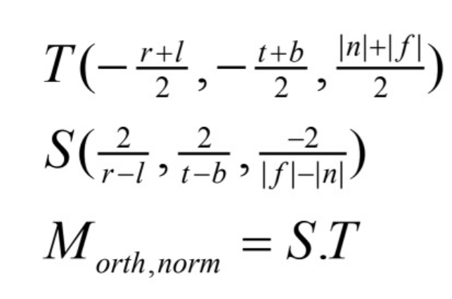
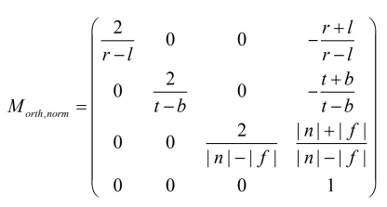
Orthographic Projection
Normalization
Ynorm
Znorm
(1,1,1)
Xnorm
(-1,-1,-1)

Slide 11
Viewport
glViewport(0, 0 ,windowWidth ,windowHeight) - sets the region within a window that is used for mapping the clipping volume coordinates to physical window coordinates.
First two parameters are the x and y coordinate values of the lower left corner of the window and the last two are the width and height of that window.
Must be less than or equal to the original window width and height.

Slide 12
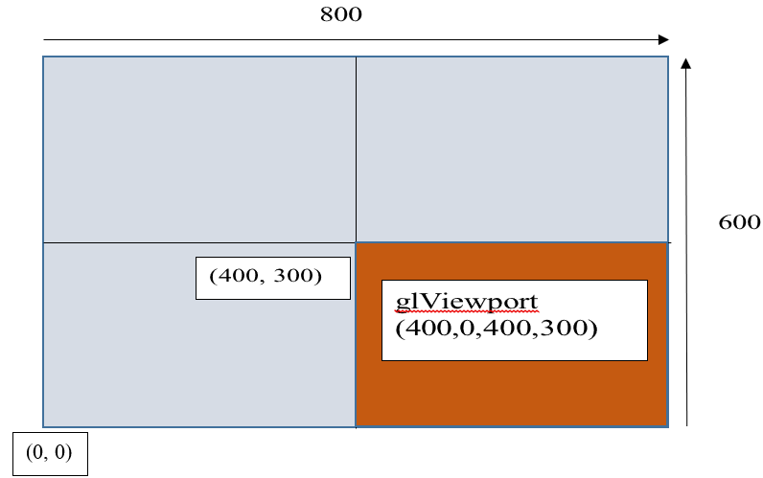
Viewport

Slide 13
GL_DEPTH_TEST
Makes OpenGL to consider the distance of objects from viewer
  Which one to render and which one to discard
By default disabled.
glEnable(GL_DEPTH_TEST);

Slide 14
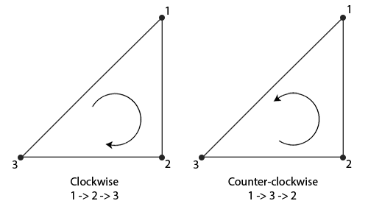
Winding order

Slide 15
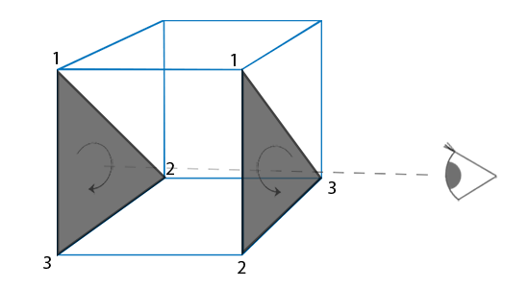
Winding order: Viewer POV

Slide 16
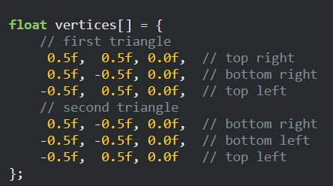
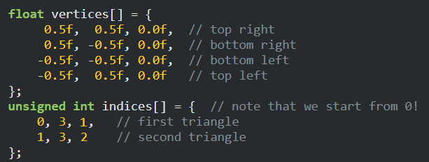
Element Buffer Object
To eliminate duplication of vertex data

Slide 17
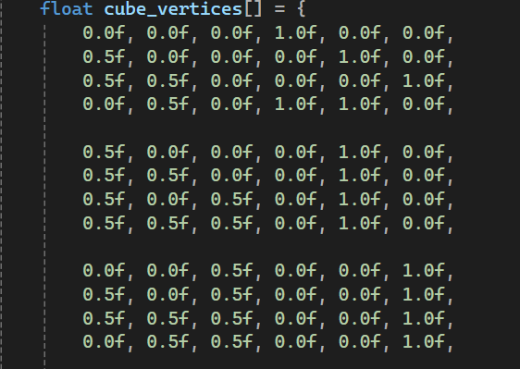
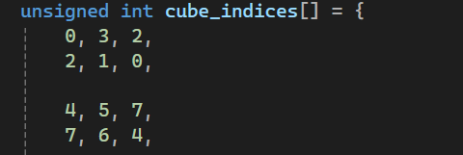
Element Buffer Object
To eliminate duplication of vertex data

Slide 18
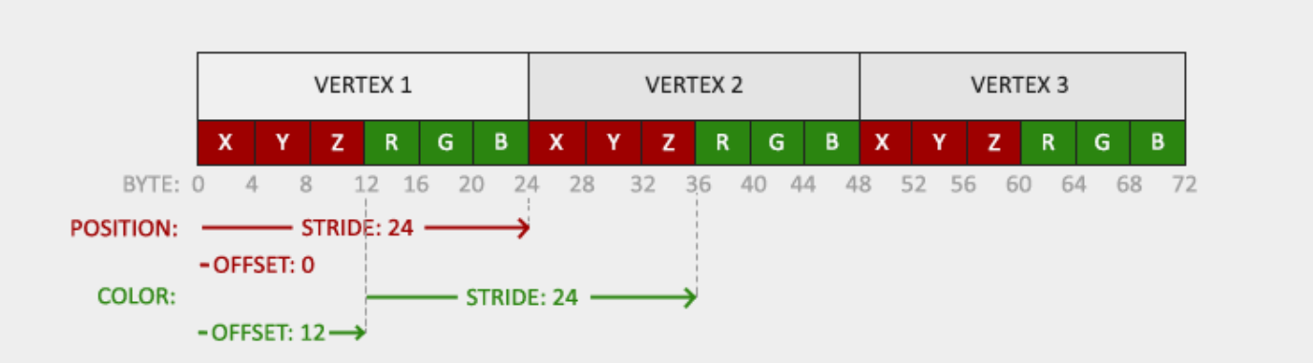
VBO Layout
VBO with Vertex attribute with Position and Color

Slide 19
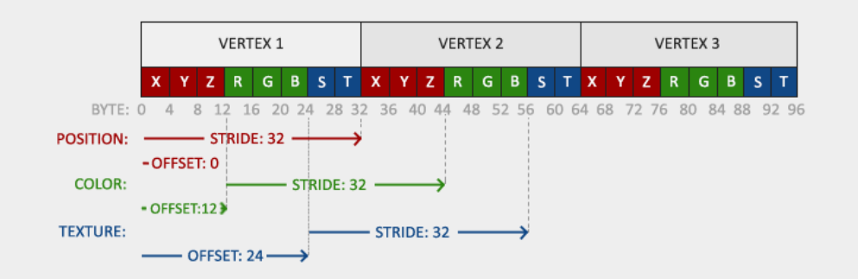
VBO Layout
VBO with Vertex attribute with Position, Color and Texture Co-ordinate

Slide 20
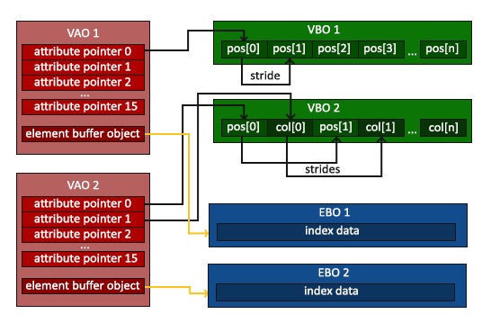
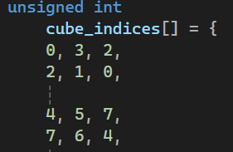
Element Buffer Object (contd.)

Slide 21
Instructions before the lab task
Follow the instructions properly.
Create a new project. (Please)
Configure the new project. [Hint: C:\opengl\Include, …]
For each shared file, do
  Create a new file in the project.
  Rename it as the given file.
  Copy the content of the given file into the new file.

Slide 22
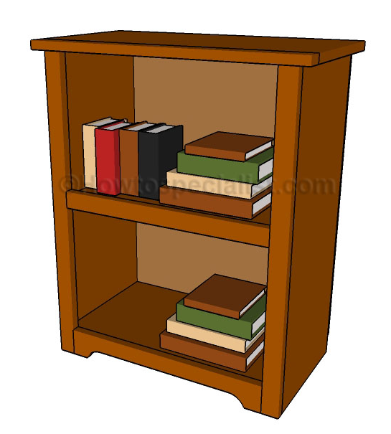
Lab Task
Draw a 3D Book Shelf

Slide 23
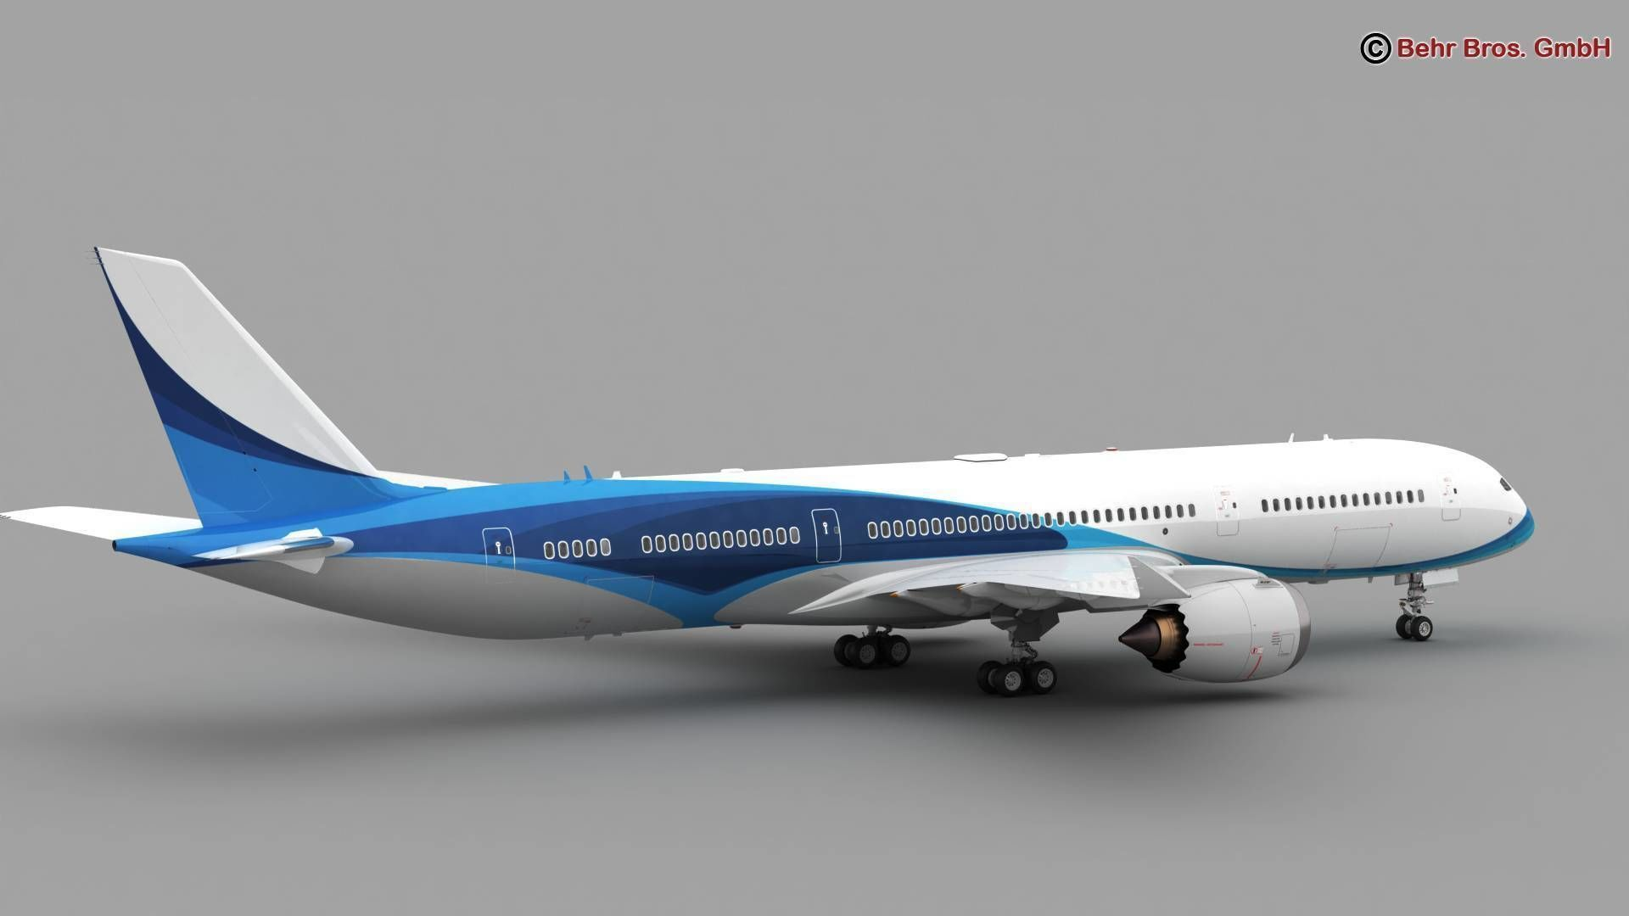
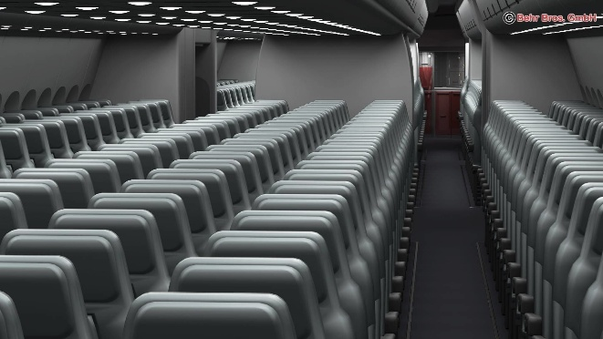
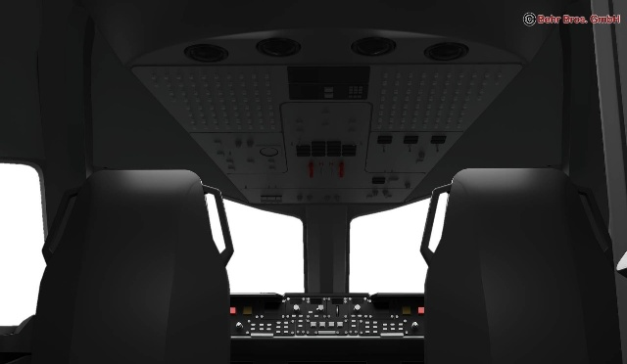
Assignment B1
Implement a viewing transformation (Bird’s Eye View like camera).
Implement Pitch (key X), Yaw (key Y) and Roll (key Z) rotations.
Implement moving forward (key W), backward (key S), left (key A), right (key D), up (key E), and down ( key R) like a flying simulator.
Implement rotating the camera around a look at point using key F.
Rotating Fan (key G), Turn on/ off light (L).
Doors and windows can be opened and closed.
Simulate take off and landing of the plane and functions of the dynamic equipment.
Create a Model of 3D Airplane

Slide 24
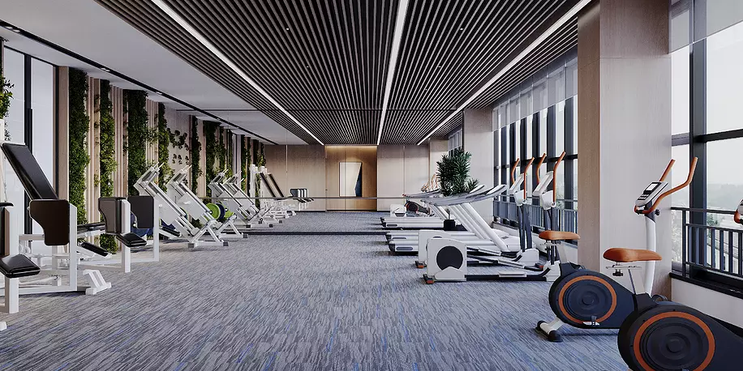
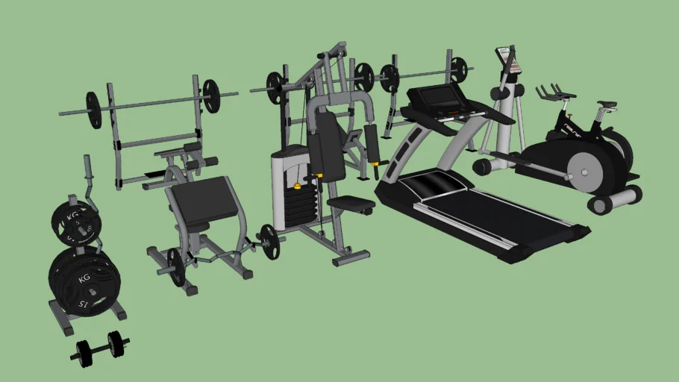
Assignment A2
Implement a viewing transformation (Bird’s Eye View like camera).
Implement Pitch (key X), Yaw (key Y) and Roll (key Z) rotations.
Implement moving forward (key W), backward (key S), left (key A), right (key D), up (key E), and down ( key R) like a flying simulator.
Implement rotating the camera around a look at point using key F.
Rotating Fan (key G), Turn on/ off light (L).
Doors and windows can be opened and closed.
Simulate the function of the dynamic equipment.
Create a Model of 3D gymnasium with different dynamic equipment

Slide 25
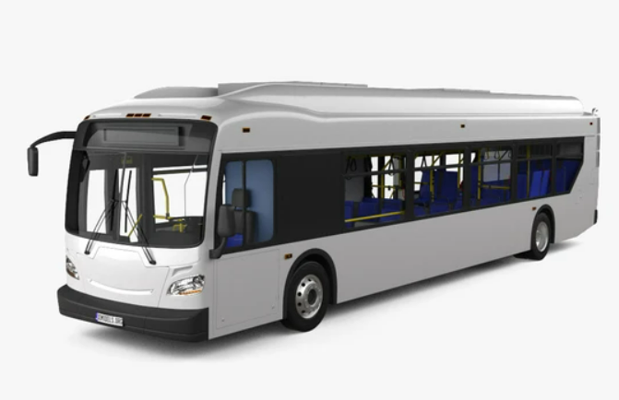
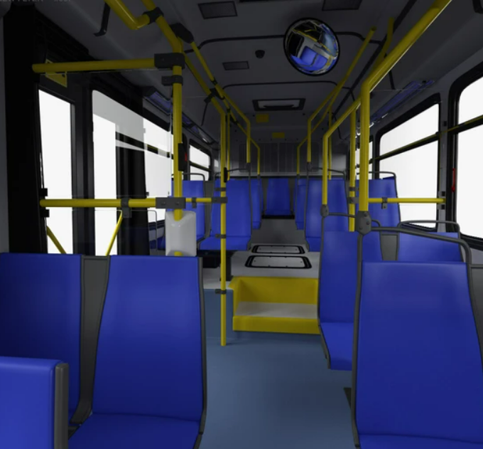
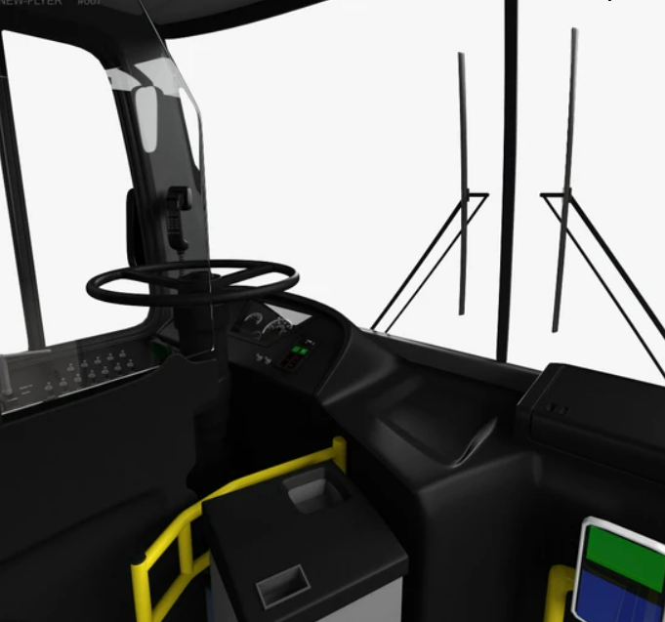
Assignment B2
Implement a viewing transformation (Bird’s Eye View like camera).
Implement Pitch (key X), Yaw (key Y) and Roll (key Z) rotations.
Implement moving forward (key W), backward (key S), left (key A), right (key D), up (key E), and down ( key R) like a flying simulator.
Implement rotating the camera around a look at point using key F.
Rotating Fan (key G), Turn on/ off light (L).
Doors and windows can be opened and closed.
Simulate driving the bus.
Draw a 3D Bus

Slide 26
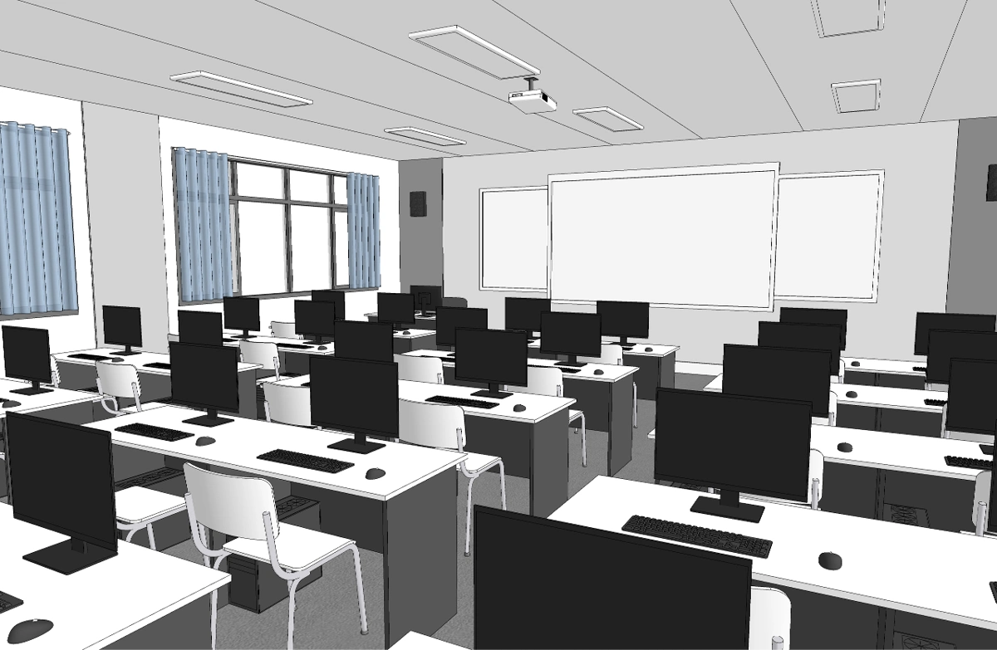
Assignment A1
Implement a viewing transformation (Bird’s Eye View like camera).
Implement Pitch (key X), Yaw (key Y) and Roll (key Z) rotations.
Implement moving forward (key W), backward (key S), left (key A), right (key D), up (key E), and down ( key R) like a flying simulator.
Implement rotating the camera around a look at point using key F.
Rotating Fan (key G), Turn on/ off light (L).
Doors and windows can be opened and closed.
Draw a 3D Laboratory

Slide 27
References
https://learnopengl.com/Getting-started/Coordinate-Systems
https://gamedev.stackexchange.com/questions/120338/what-does-a-perspective-projection-matrix-look-like-in-opengl
https://www.geeksforgeeks.org/window-to-viewport-transformation-in-computer-graphics-with-implementation/
Dr. Sk. Md. Masudul Ahsan, (2022), L4 3D Viewing2_HoV1 [PDF document], Khulna University of Engineering & Technology.

